Slide 1
Beyond the Likes:
Social Media Analytics

Slide 2
Introduction
Social media is an integral part of today’s digital world, generating enormous amounts of data every day.
However, this data is often stored in complex and structured formats, making it difficult to view, interpret, and derive meaningful insights.
Social Media Analytics using SQL transforms raw social media data into clear and meaningful insights.

Slide 3
Key
Objectives
Generate Data-Driven Insights
Analyze User Activity
Measure Post Engagement
Analyze Follower Patterns
Discover Trending Hashtags
Measure Engagement Rate
Analyze Posting Patterns
Compare Country-wise Performance

Slide 4
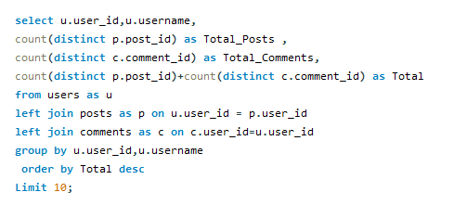
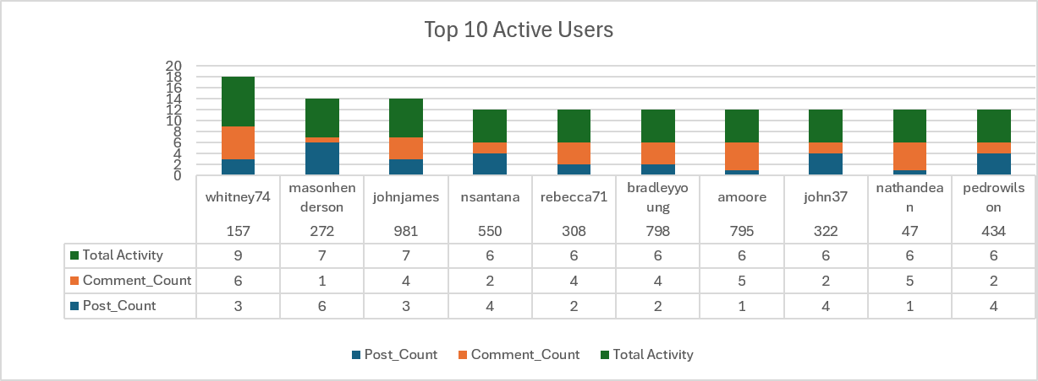
Most Active Users
Insights
Used SQL Aggregation and Join to identify the most active users.
The analysis highlights the Top 10 active users based on their combined posts and comments.
Users with higher combined activity can be considered highly engaged users.
These users actively create content and participate in discussions.
The activity data can further be used to classify users into different user types based on their level of engagement.

Slide 5
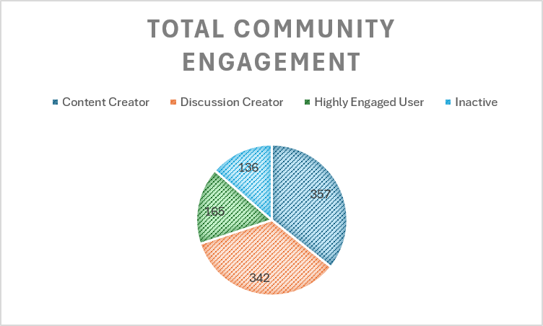
Type of End user
Assumptions
Content Creator =Content Score>Discussion Score
Discussion Creator = Discussion Score > Content Score
Highly Engaged User =Both Scores equal > 0
Inactive = Both Score = 0

Slide 6
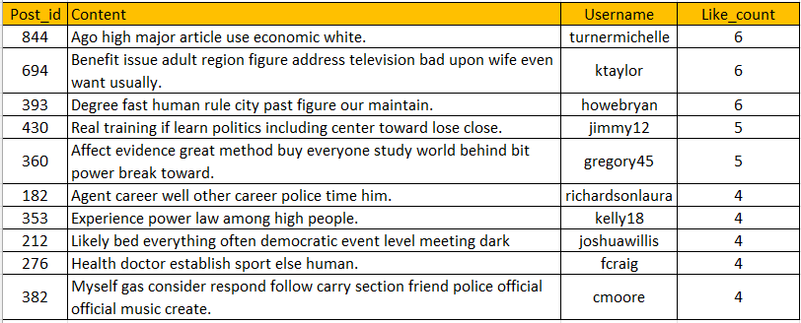
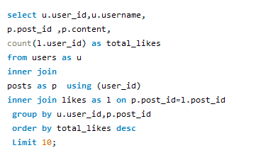
Most Liked Post & their Creators
Query Used
Used group by & Join to find top 10 liked content along with the username and their like counts.
Top-performing posts received only 6 likes, showing relatively low engagement.
3 posts are tied at the highest likes, so there is no single post dominating the engagement.

Slide 7
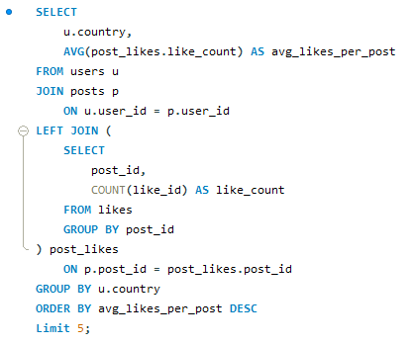
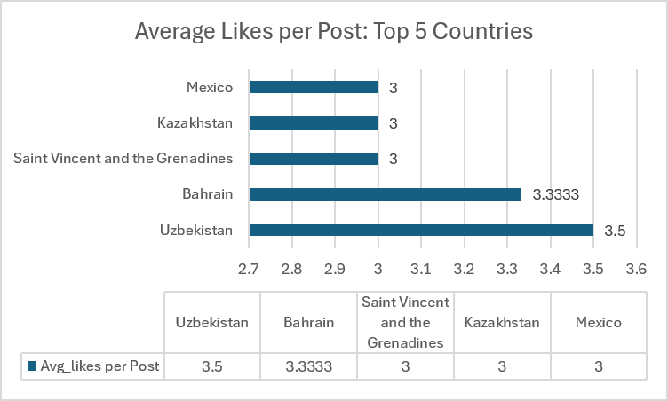
Top 5 Countries by Average Engagement
Used Aggregation and join to find out average likes per post by country by joining users ,posts, likes, aggregating likes at the post level, and then averaging those post-level like counts by country.
Uzbekistan leads in average engagement with 3.5 likes per post, outperforming the other countries in the analysis

Slide 8
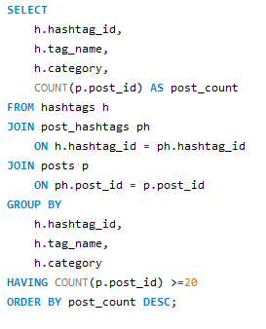
Trending Hashtags
Query Used
The above query was designed to identify trending hashtags used in more than 20 posts.
However, the query did not return any results for the given dataset.
We then adjusted the post-count threshold from 20 to a range of 1–5 posts.
After lowering the threshold, the query successfully returned results.
This indicates that no hashtags in the dataset were used in more than 20 posts.

Slide 9
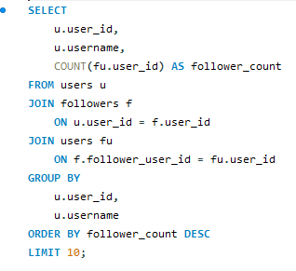

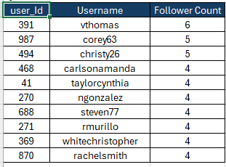
Top Influencers
Query Used
Used Self Join and Aggregation to identify the Top 10 influencers based on their follower count.
Using the schema, the followers table already represents a user-to-user relationship, so we can join it with users and aggregate follower counts.
The results are ranked in descending order, from the highest to the lowest number of followers.

Slide 10
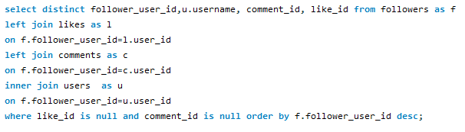
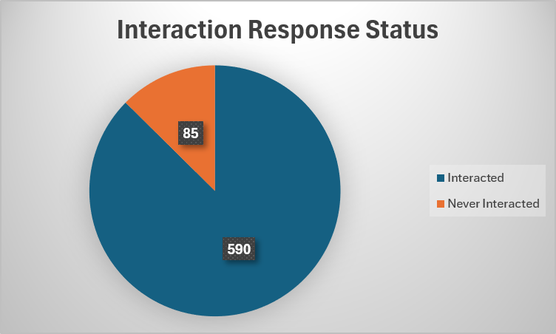
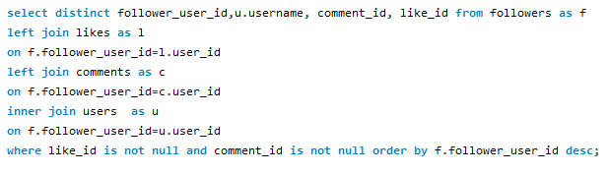
User-Follower Interaction Analysis
Users who follow others but never interacted
User who follow other and have interacted
We were able to identify user interaction status and classify users into two categories: Interacted vs. Never Interacted.
The analysis shows that the percentage of interacted users is higher than that of never-interacted users in the dataset.

Slide 11
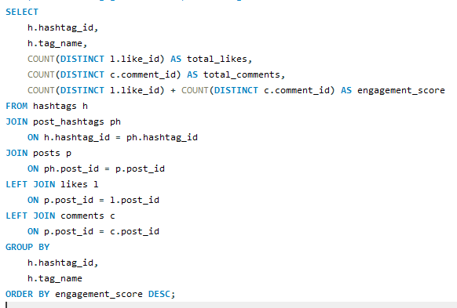
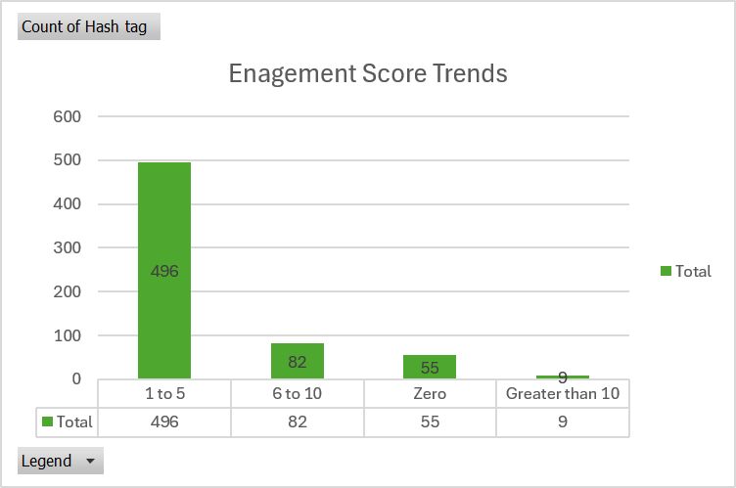
Engagement Score per Hashtag
Engagement Rate can be calculated as: (Total Likes + Total Comments) / Total Posts.
We used a multi-table JOIN to calculate the engagement rate, which returned 642 Hashtags.
Since the complete query output could not be presented, the results were grouped into engagement score ranges, from 0 to greater than 10, for easier analysis and visualization.

Slide 12
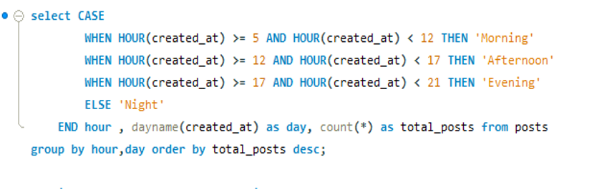
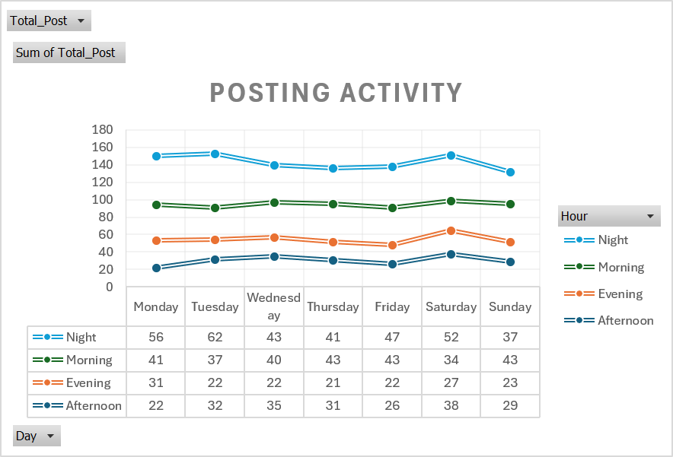
Posting Activity
Used GROUP BY and date functions to identify the busiest posting periods.
The analysis combines day of the week and time of day to determine when users are most active.
Tuesday recorded the highest number of 153 posts among all weekdays.
The average number of posts per day is 35.71 across the dataset.

Slide 13
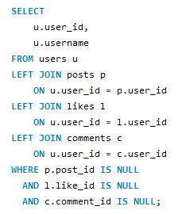
Inactive Users
Query Used
Used LEFT JOIN and NULL filters to identify inactive users from the dataset.
The analysis identified 47 inactive users who had not created posts, liked posts, or commented.
These users showed no recorded engagement activity within the dataset.

Slide 14
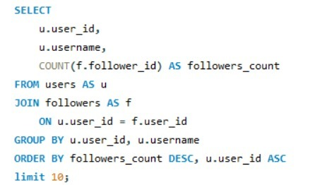
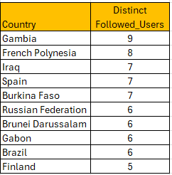
Top 10 countries with most influencers
Used Multi Join & Aggregation to find top 10 countries with most influencers.
Gambia leads with 9 distinct followed users, making it the highest in the dataset.
French Polynesia ranks second with 8 distinct followed users.
Iraq, Spain, and Burkina Faso follow with 7 users each.
Russian Federation, Brunei Darussalam, Gabon, and Brazil recorded 6 distinct followed users each.
Finland has 5 distinct followed users, the lowest among the countries shown.
Overall, the difference between the highest and lowest values is relatively small (9 vs. 5), indicating a fairly close distribution among these countries.

Slide 15
Key Takeaways
The overall engagement rate for the dataset is 2.0, based on the defined engagement formula.
We learned that query optimization is not only about making SQL run faster,it is also about reducing unnecessary processing, avoiding duplicate results, and writing queries that are clear, accurate, and efficient.
The biggest challenge was ensuring that complex joins and aggregations produced accurate results without duplicate or inflated counts.
Gen AI acted as a learning and problem-solving assistant, helping me understand the data, build SQL solutions, validate results, and present insights effectively.
Gen AI vs. Written Queries: Gen AI is becoming an integral part of our day-to-day work. However, understanding how to write clear and effective prompts is essential to ensure that the results generated are accurate, relevant, and aligned with the requirement

Slide 16
Q & A

Slide 17
Thank You

